Slide 1

Tata Data Visualisation: Empowering Business with Effective Insights virtual experience programme
By : Rachit Rawat

Slide 2
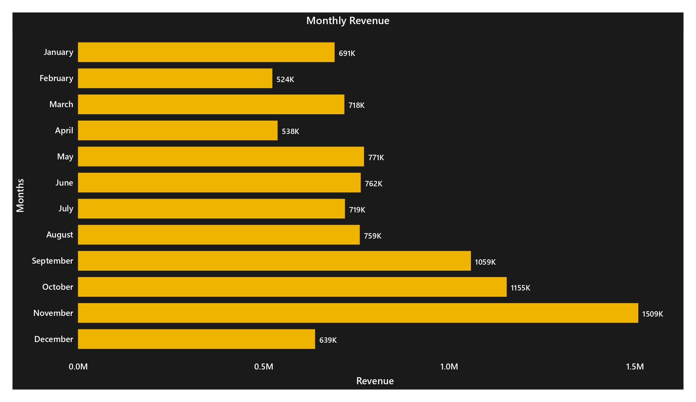
Monthly Revenue
Stable revenue of 685k per month.
Sales increased from September to November.

Slide 3
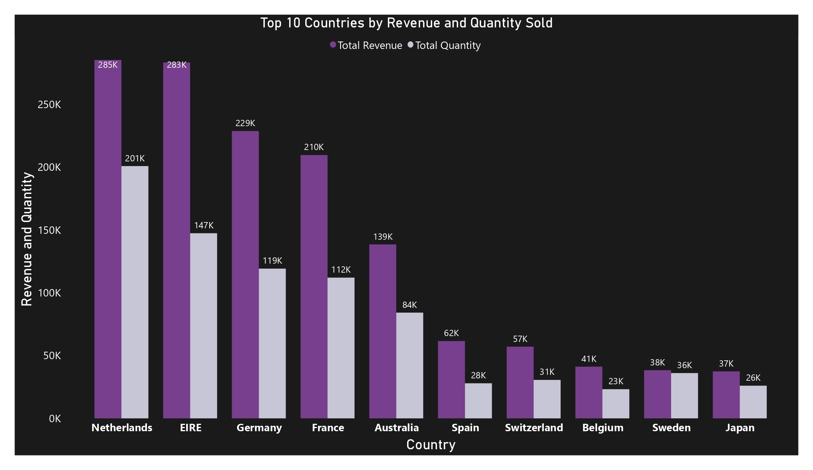
Revenue and Quantity
Netherlands, Eire, Germany, France and Australia are the top 5 Revenue Generating Countries.

Slide 4
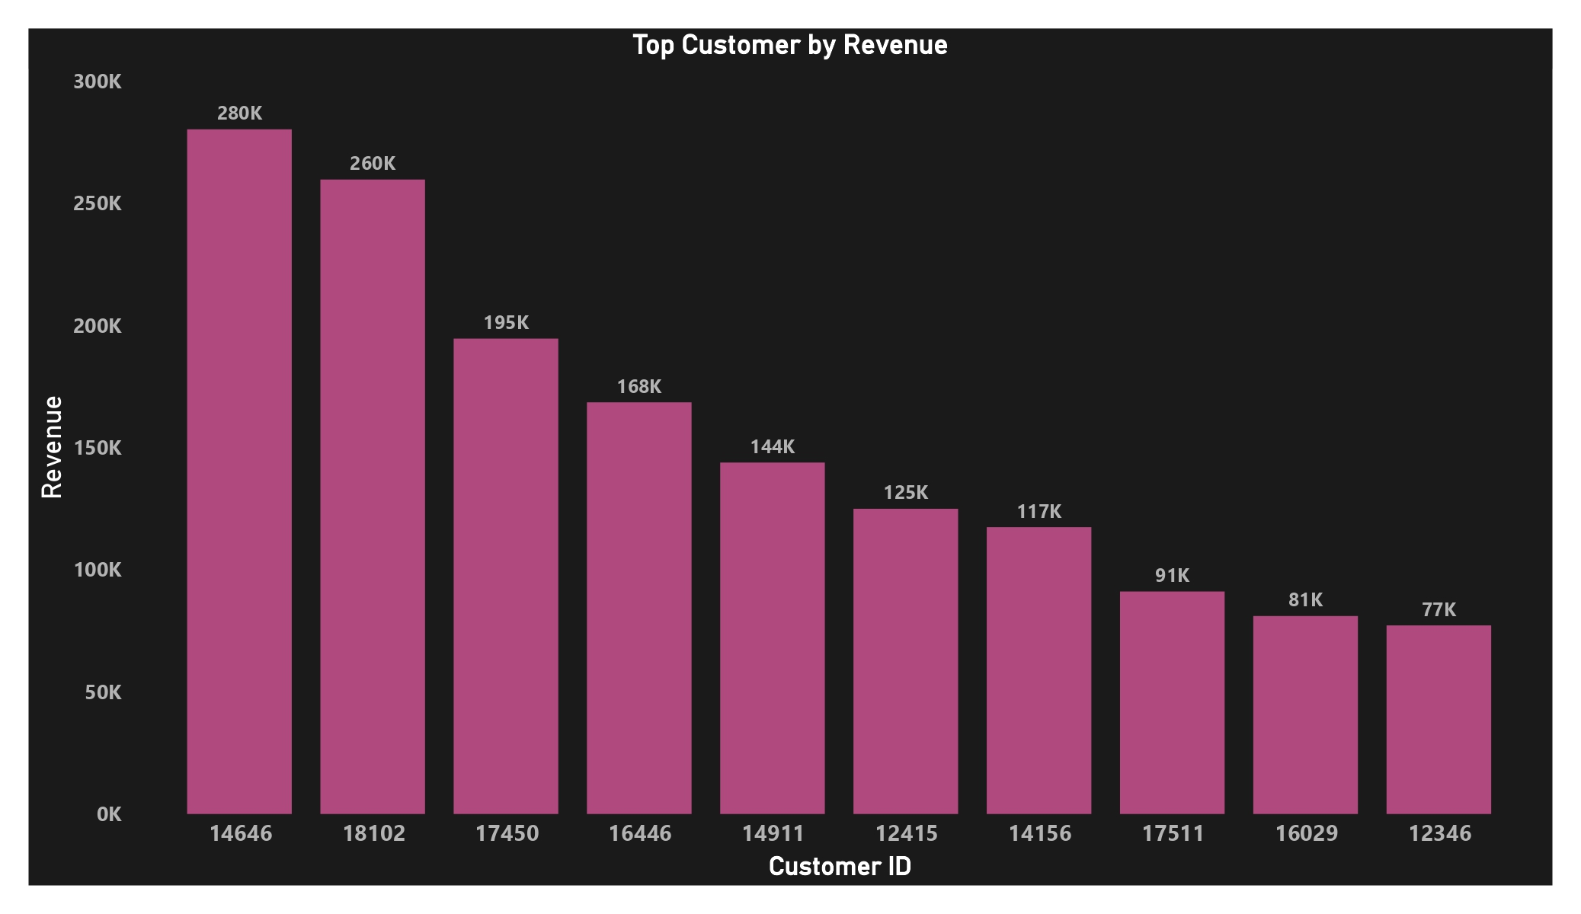
Revenue by customer
Customer 14646 made the most purchases of 280k.

Slide 5
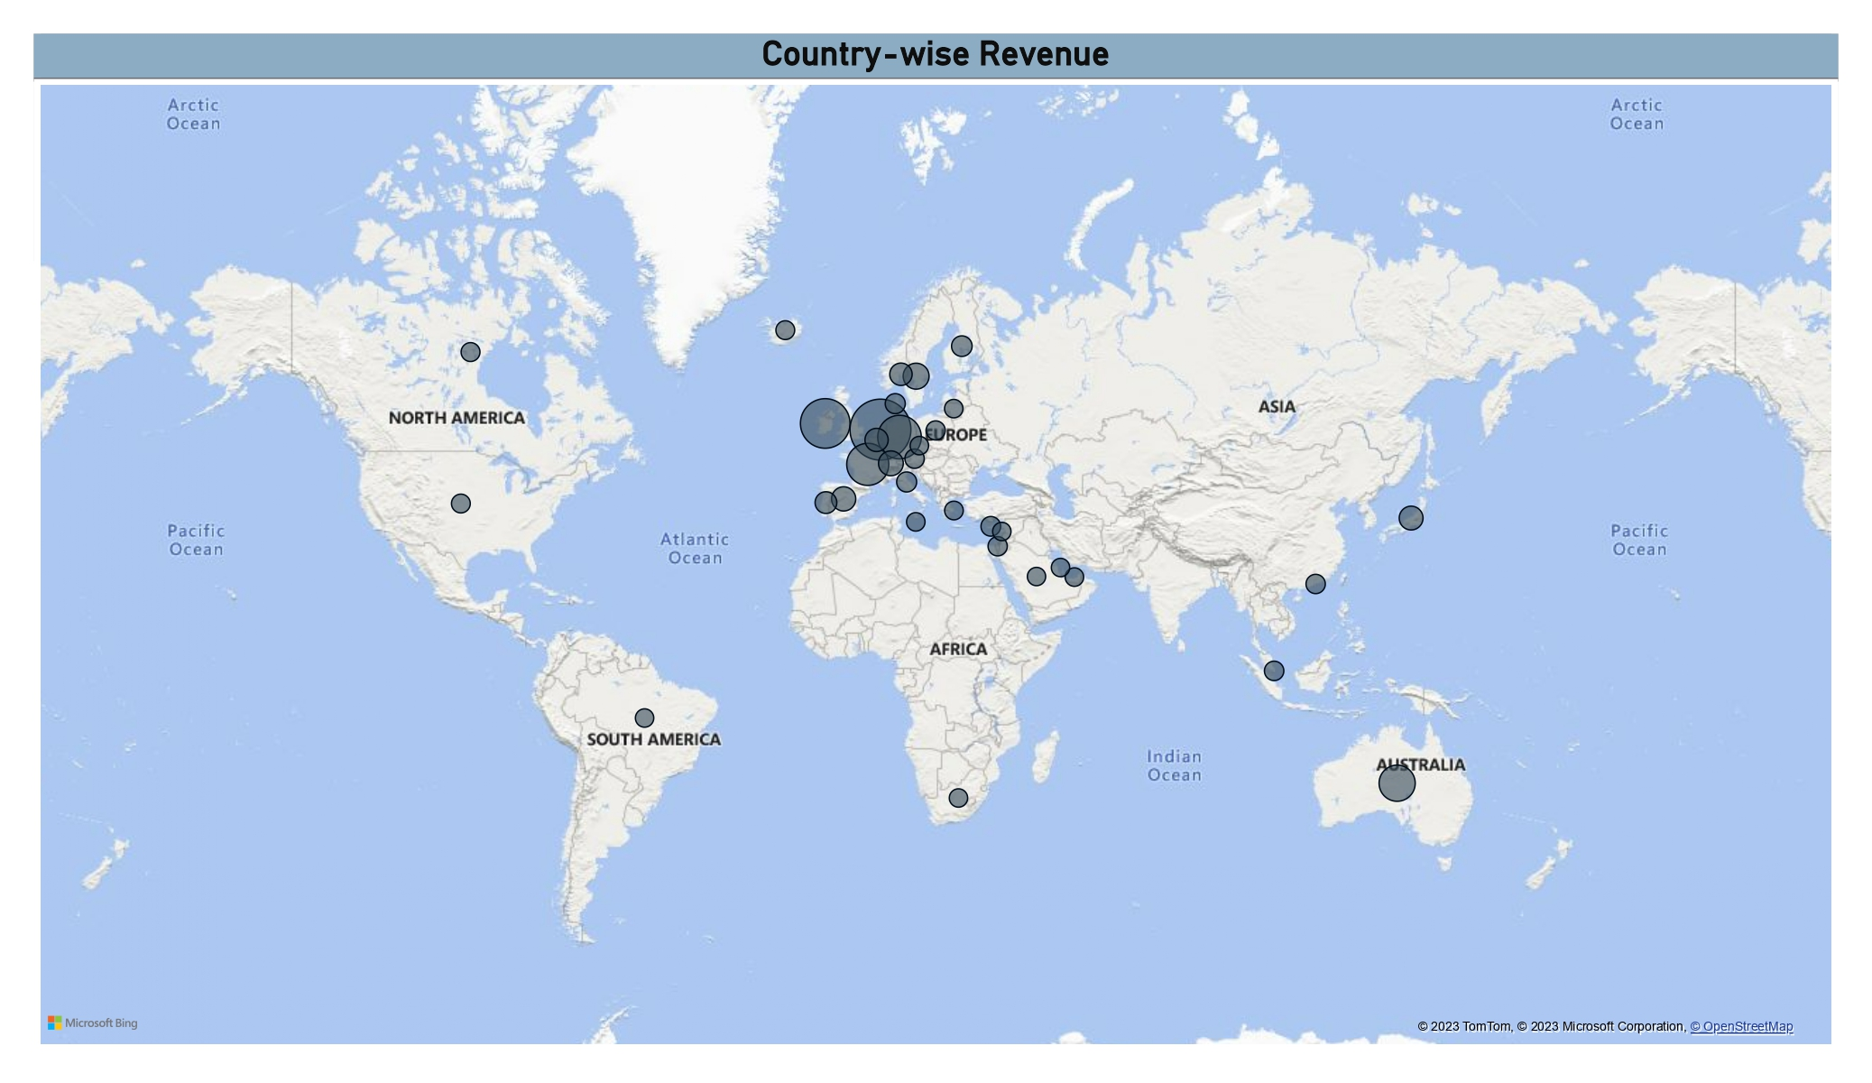
Country-wise Revenue
Netherlands, Ireland, Germany, France and Australia generates high profit

